Slide 1
SDN Based Threat Vector And Security Solutions
(Research)
Team: SPRINT
Anand Kumar
Amogh Eshappa Setra
Nandan Goudar
Sachin Uplaonkar

Slide 2
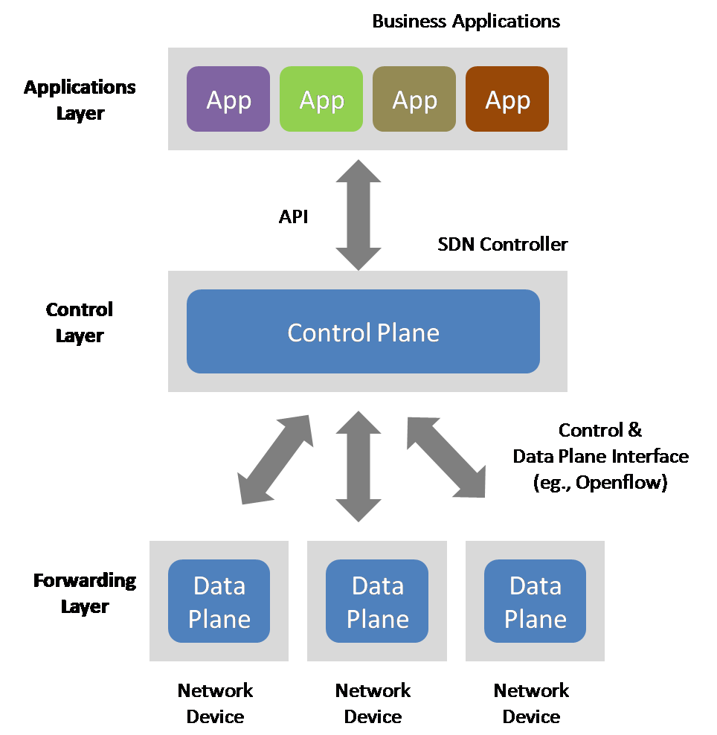
What is SDN?
Three layer architecture
Centralized intelligence

Slide 3
Two Key Definitions
Data Plane: processing and delivery of packets
– Based on state in routers and endpoints
– E.g., IP, TCP, Ethernet, etc.
– Fast timescales (per-packet)
Control Plane: establishing the state in routers
– Determines how and where packets are forwarded
– Routing, traffic engineering, firewall state
– Slow time-scales (per control event)

Slide 4
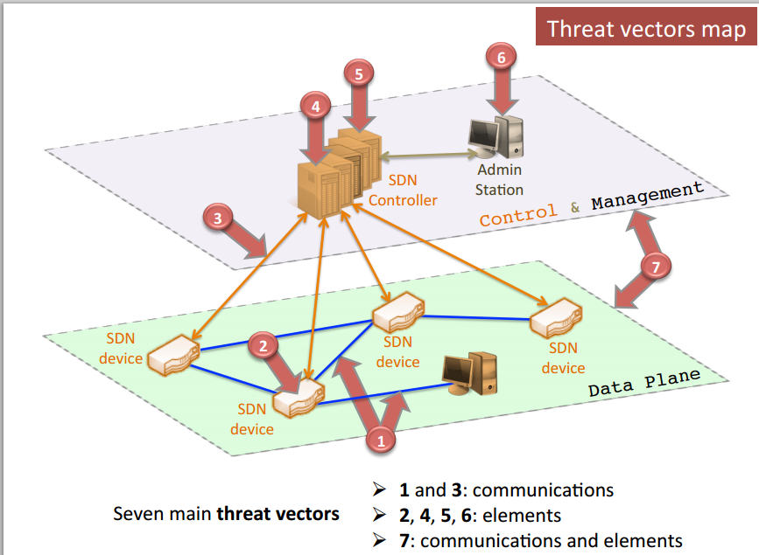
SDN Threat Vectors

Slide 5


Examples
Host Hijacking
- Controller maintains a Host Profile for each host. It either creates a new Host profile or Updates existing profile whenever it receives a PacketIn Message.
- No Authentication
- Verify the Legitimacy of Host Migration
Link Fabrication Attack
- To learn the about links between the switches.
- The integrity/origin of LLDP packets must be ensured during the Link Discovery procedure
- The propagation path of LLDP packets can only contain OpenFlow-enabled switches

Slide 6

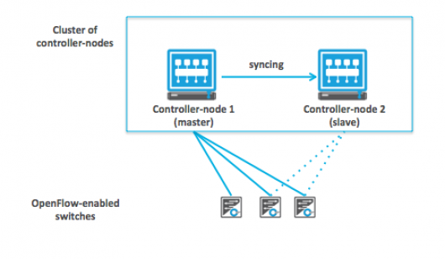
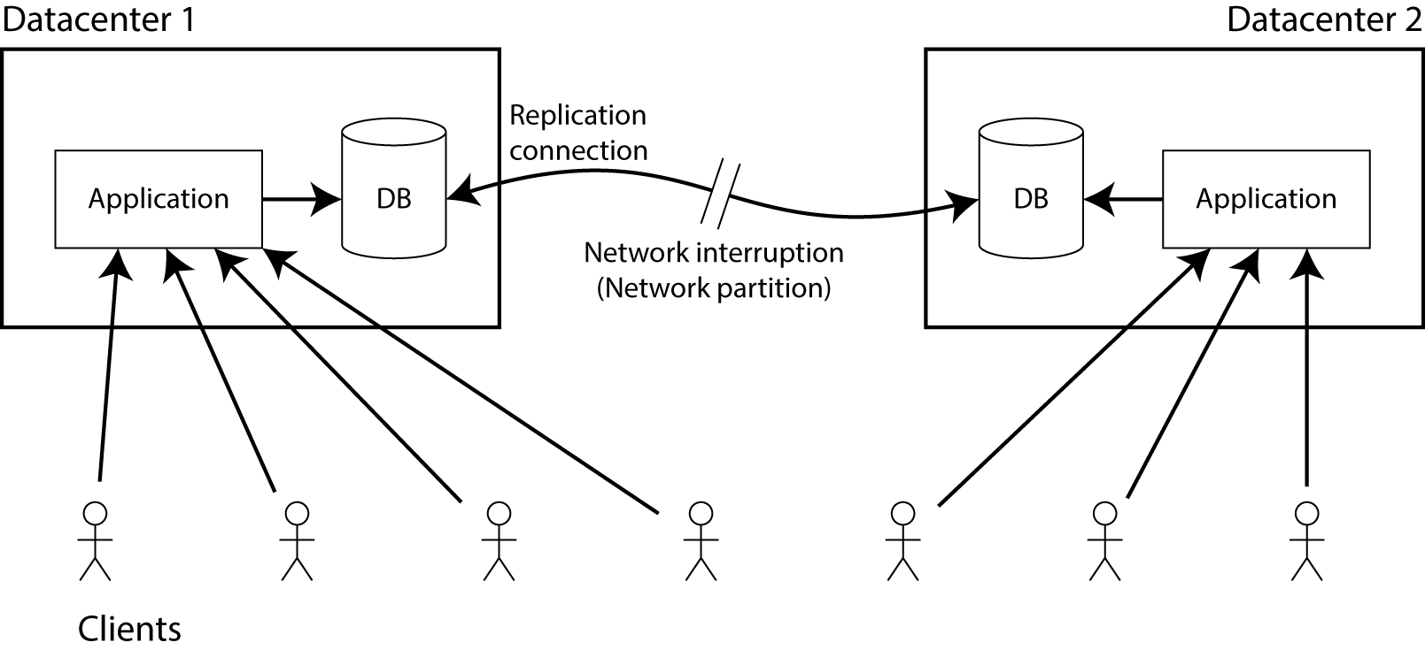
Present Security Solutions
Enforce TLS standard
Network partitioning
Cluster of controllers
Verify applications Network Partition
Trust between devices and controllers
Diverse controllers can avoid common vulnerabilities
Clustering
Notes:
Replication.
Diversity
Self-healing Systems
Dynamic Device Association
Trust between devices and controllers.

Slide 7
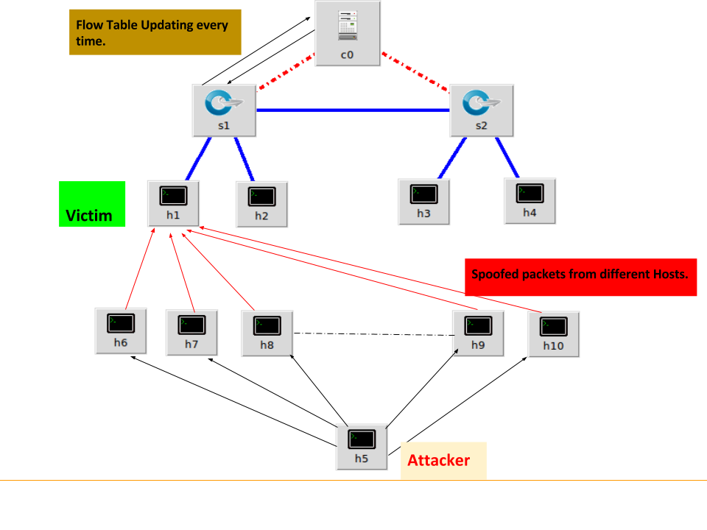
DDoS in Action
Attacker constructs an attack network.
They wait for specific time to start the attack. Either by remotely activating the hack to wakeup simultaneously or program in advance.
Victim’s system is flooded with useless load and exhausts its resources.

Slide 8
Early detection of DDoS attack
The term early is subjected to tolerance level and traffic being handled by the controller
Results in controlling flooding of malicious packets significantly.
The early detection mechanism must be of light weight and should have high response.
The high response time helps the controller in regaining the control during DDOS.
Detecting the ENTROPY variation in the destination address

Slide 9
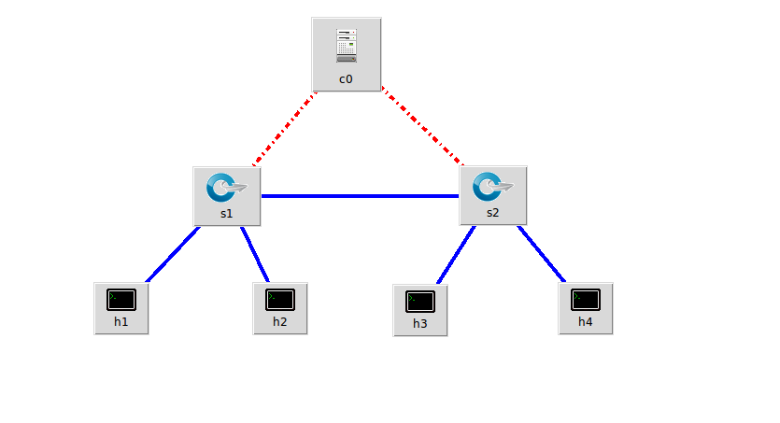

Simulation of DDoS
Mininet
- Create a tree topology with n switches and m hosts.
Pox
Python SDN Controller
Scapy
Fabricate IP packets to emulate real traffic.

Slide 10
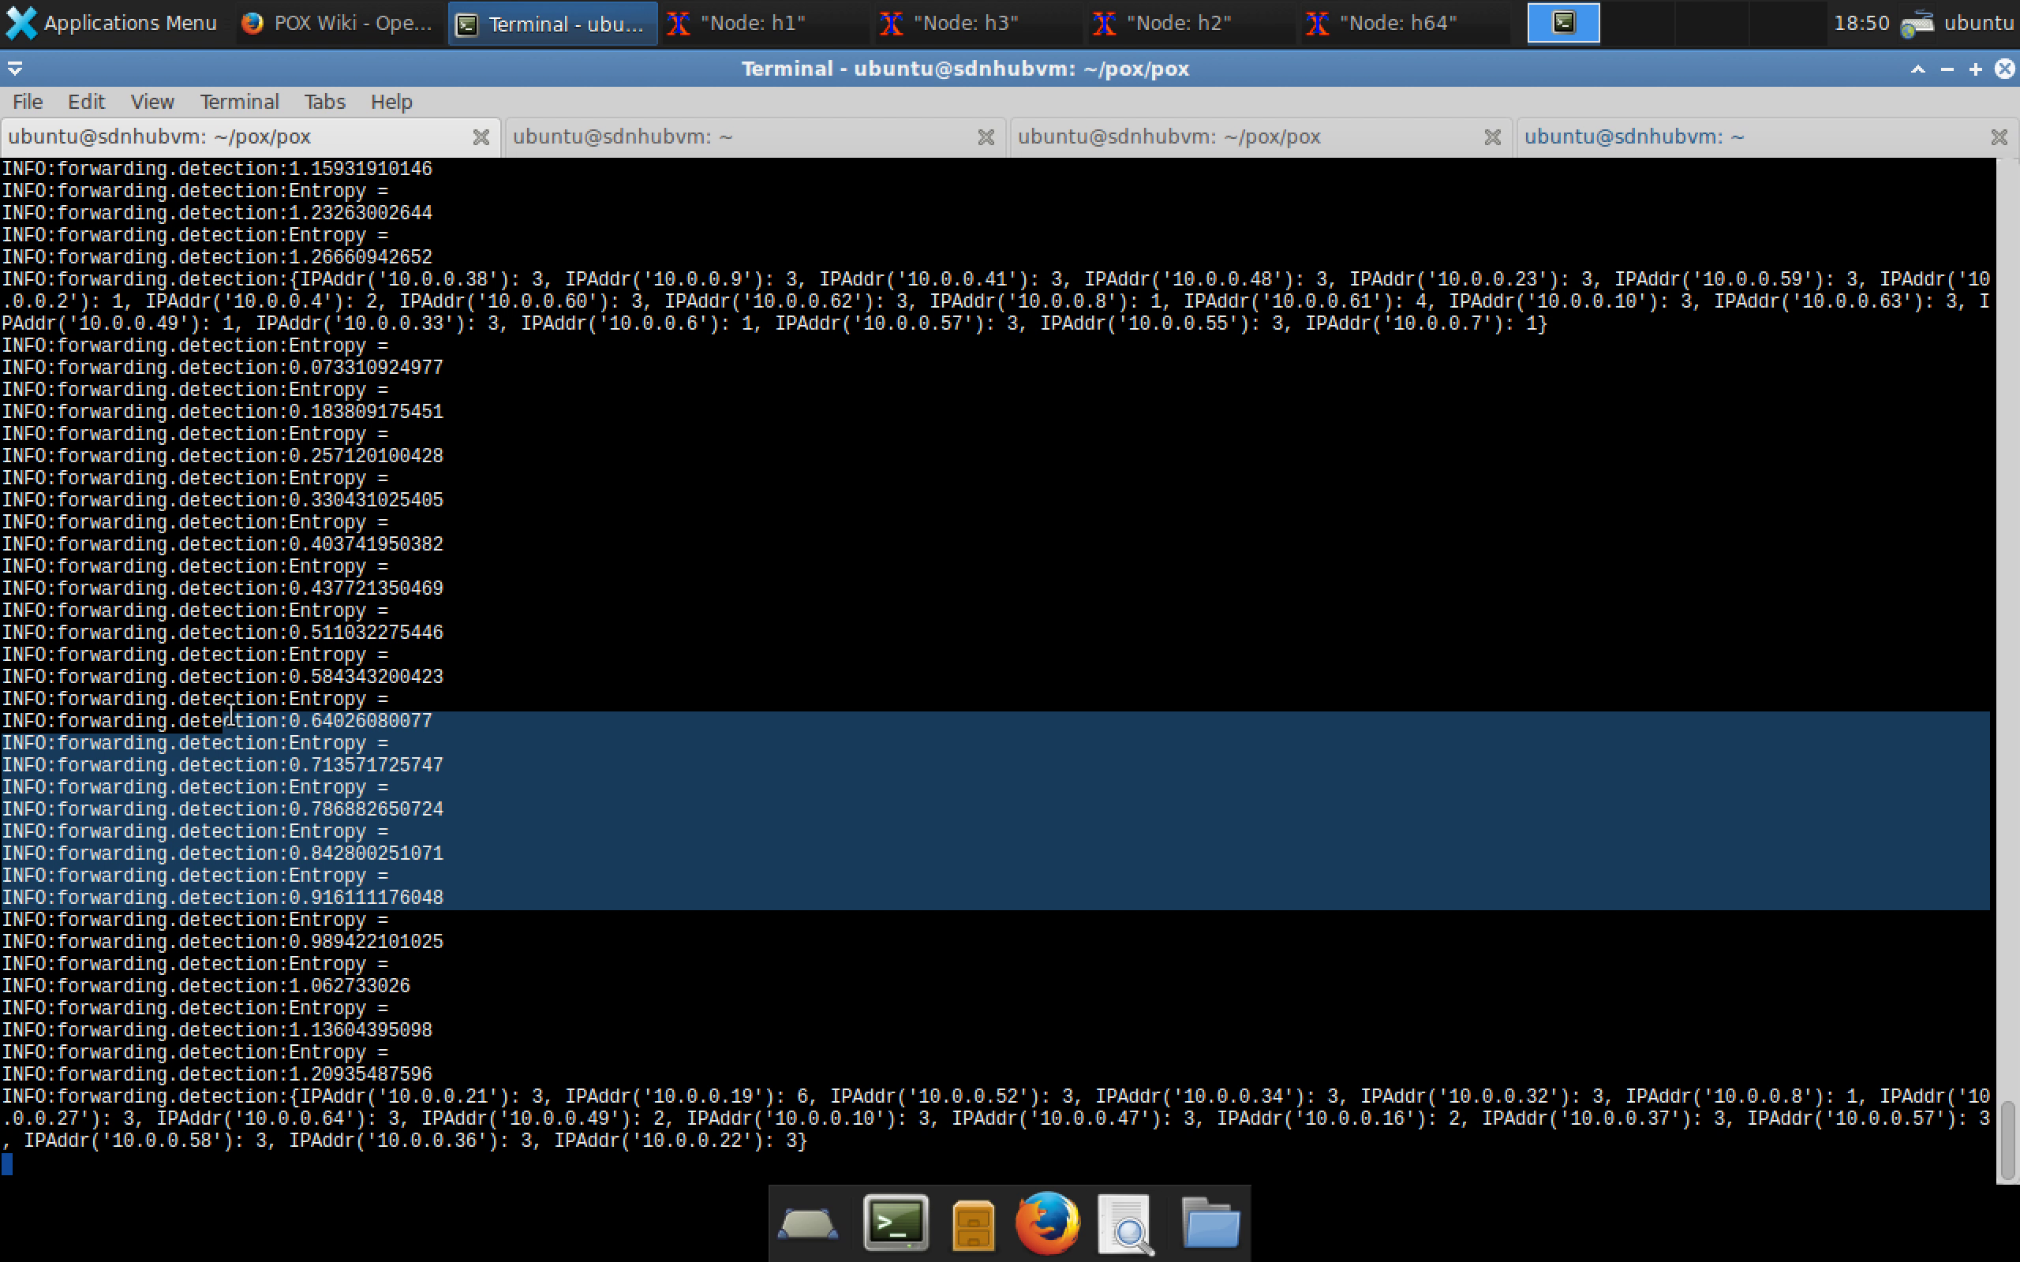
Simulation Results
Entropy – Measure of randomness

Slide 11
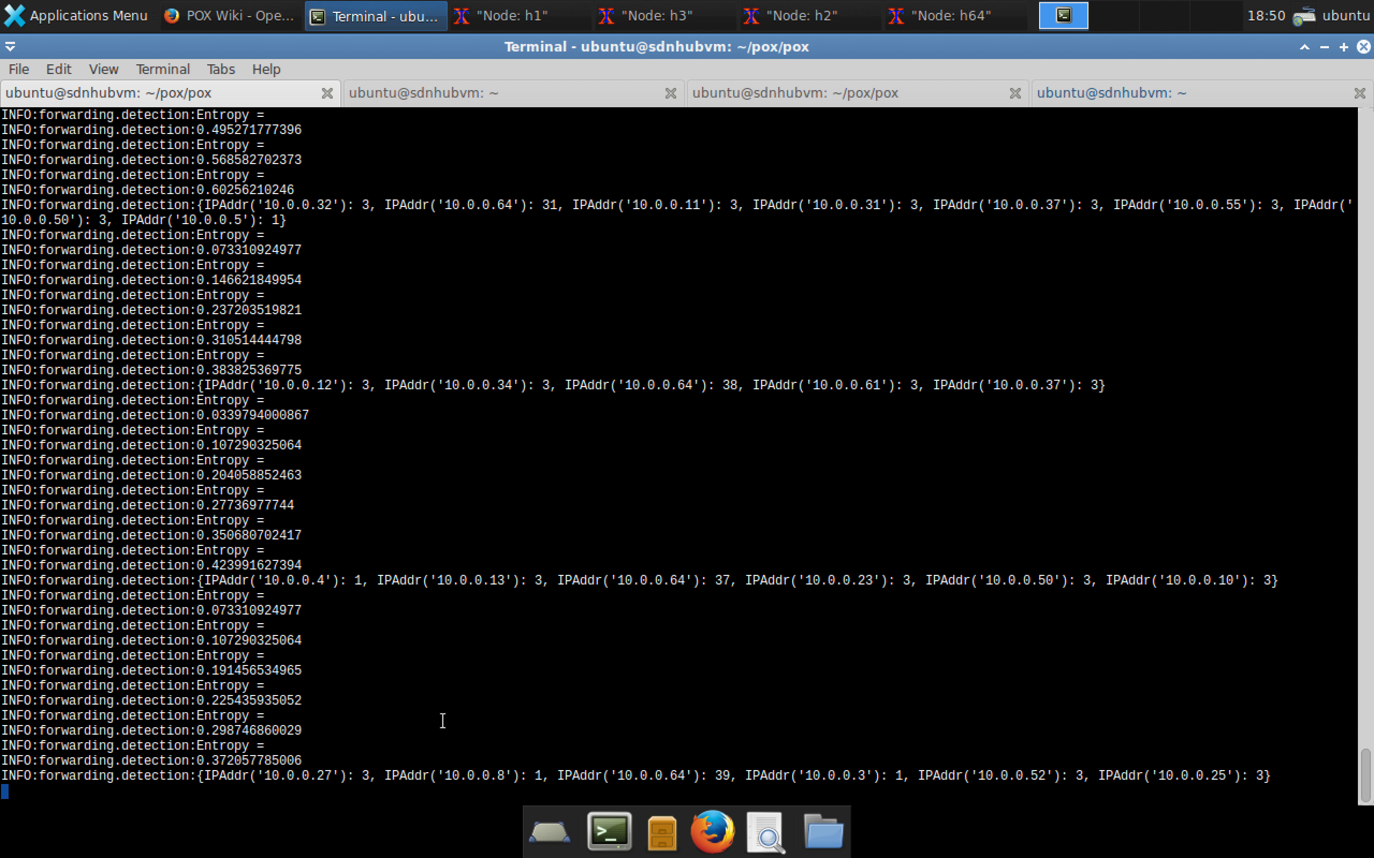
Entropy during DDoS attack

Slide 12
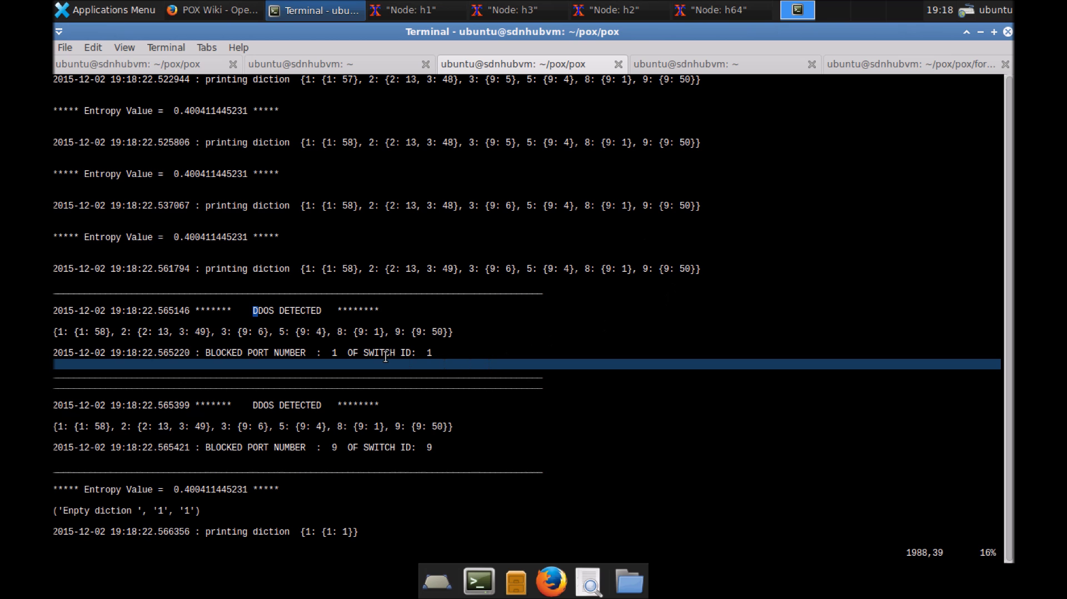
Detection and Prevention of DDoS

Slide 13
Demo (https://drive.google.com/open?id=0B3TljGdKR6tnaWN0NE9heWxTdnM)

Slide 14
References
http://conferences.sigcomm.org/sigcomm/2013/papers/hotsdn/p165.pdf
Poisoning Network Visibility in Software-Defined Networks: New Attacks and Countermeasures
Early detection of DDoS attacks against SDN controllers
Handling intrusion and DDoS attacks in Software Defined Networks using machine learning techniques

